Slide 1






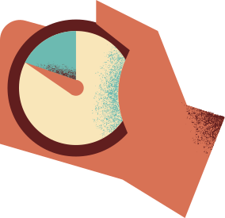



CAPSTONE PROJECT
First one - one meeting
Presentation by Charushree Anil

Slide 2




IMPACT OF LIFESTYLE HABITS ON ANXIETY ATTACK SEVERITY

Slide 3

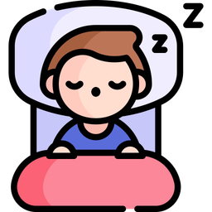





BACKGROUND
Anxiety attacks can be influenced by everyday habits like sleep, exercise, caffeine, and alcohol intake. This study explores how these lifestyle choices affect anxiety severity using real-world data. By analyzing patterns, we can uncover insights to help people manage anxiety better!

Slide 4
DATA
Dataset contains 12,000+ records detailing various factors related to anxiety attacks, including demographics, lifestyle habits, stress levels, and physiological responses. It is designed for data analysis, machine learning, and mental health research, helping to explore patterns, triggers, and potential correlations in anxiety disorders.
Key Features:
🧑‍🤝‍🧑 Demographics: Age, Gender, Occupation
🌙 Lifestyle Factors: Sleep, Physical Activity, Diet, Caffeine & Alcohol Intake
💓 Health Indicators: Heart Rate, Breathing Rate, Sweating, Dizziness
🧠 Psychological Factors: Stress Level, Family History, Therapy & Medication
⚠️ Anxiety Attack Severity: Scale from 1 to 10
Dataset link: link

Slide 5

IDEAS FOR THE PROBLEM
  Impact of Lifestyle Habits on Anxiety Attack Severity
  The Role of Psychological Factors in Predicting Anxiety Attacks
  Comparing Health Indicators: Heart Rate vs. Breathing Rate in Anxiety Attacks
  Effectiveness of Therapy and Medication in Managing Anxiety Severity

Slide 6



THANK YOU

